Slide 1
FUNDAMENTALS OF INFORMATION SECURITY
Session 9
COURSE CODE:
CYBE 6123
LECTURER: NGUEMETA NATHANIEL
The University Of Bamenda

Slide 2
Security Operations and Administration
The University Of Bamenda

Slide 3
Objective of the session
What security administration is
What compliance is
What professional ethics are
What the infrastructure for an information technology (IT) security policy is
What data classification standards are
What configuration management is
What the change management process is
What the system life cycle (SLC) and system development life cycle (SDLC) are
How software development relates to security
The University Of Bamenda

Slide 4
Security Administration
Sensitive assets list—What assets must the organization take measures to secure?
The organization’s security process—How does it all work?
The authority of the persons responsible for security—Which administrator is responsible or authorized for what assets and actions?
The policies, procedures, and guidelines adopted by the organization—What information needs to be communicated, how is it communicated, and when is it communicated?
The University Of Bamenda

Slide 5
Security Outsourcing
Advantages
An external security management firm has a high level of expertise because it focuses on security
Disadvantages
The outsourcing firm might not know the organization well nor possess enough internal knowledge necessary to protect its assets.
The organization will not be developing its own in-house capability for security management, hence they remain dependent
The University Of Bamenda

Slide 6
Security Outsourcing - Considerations
Privacy—Does the third party agree to uphold the organization’s privacy policy? How does it plan to control how data is collected, stored, handled, and destroyed?
Risk—What additional risks exist by transferring data over a trust boundary? How are any new risks addressed? Who is responsible for managing new outsourcing risks?
Data security—What controls protect data confidentiality and integrity from unauthorized access? Are access controls consistent with internal controls? How is data availability protected? Are backups and redundancy measures in place to minimize downtime? How are back-ups and redundant data copies protected?
Ownership—Who owns the data, the infrastructure, and the media? Who is responsible for each component?
Adherence to policy—Does the third party commit to upholding the organization’s security policies and procedures?
The University Of Bamenda

Slide 7
Security Outsourcing - Considerations
Service level agreement (SLA)
Blanket purchase agreement (BPA)
Memorandum of understanding (MOU)
Interconnection security agreement (ISA)
The University Of Bamenda

Slide 8
Compliance
Definition
The state or fact of according with or meeting rules or standards.
Requires clear statements and unambiguous criteria
Principles
Adherence to criteria of operations
Requires details pertaining to different aspects of governance and operations
Can be regulatory, legal, contractual, or policy-based
Bottom-line is to provide common perspective and baseline practices
The University Of Bamenda

Slide 9
Ensuring Compliance
Event logs
Record of actions taken on systems
Very useful to detect incidents and intrusion in the early stages
Requires proper fine-tuning
Compliance liaison
Monitors and reports on adherence to company policies
Assists in understanding of compliance requirements, and provides necessary training
Remediation
Helps in mitigating risks and responding to incidents should they occur
Monitors and responds to vulnerabilities which could affect the environment
The University Of Bamenda

Slide 10
Professional Ethics
Set the example— Security professionals must demonstrate strong ethical principles in their daily activities so that users will follow their lead.
Encourage adopting ethical guidelines and standards—Security professionals must know their ethical boundaries and set an example by adhering to them,
Inform users through security awareness training—Security professionals must ensure that users are aware of and understand their ethical responsibilities.
The University Of Bamenda

Slide 11
Personnel Security Principles
Limiting Access
Separation of Duties
Job Rotation
Mandatory Vacations
Security Training
Security Awareness
Social Engineering
Intimidation
Name-dropping
Appeals for help
Phishing
The University Of Bamenda

Slide 12
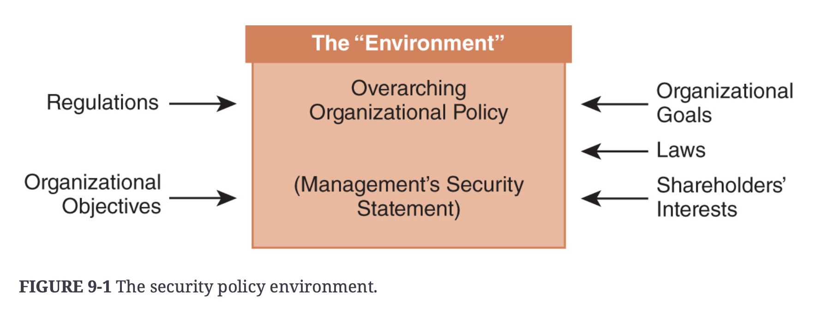
Organizational Security Policy
The University Of Bamenda

Slide 13
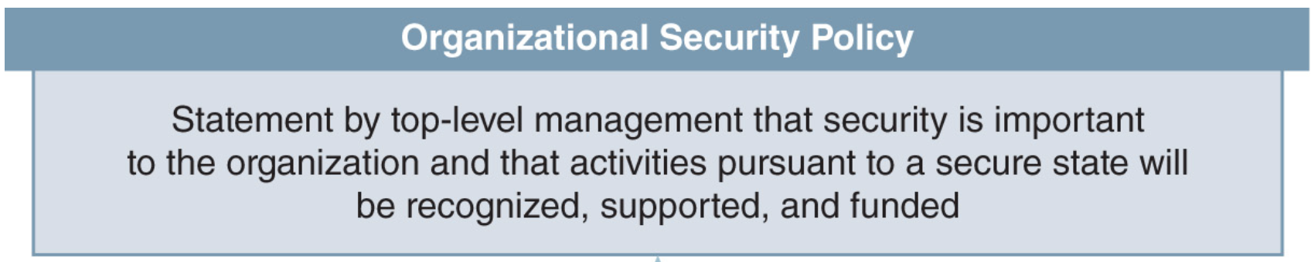
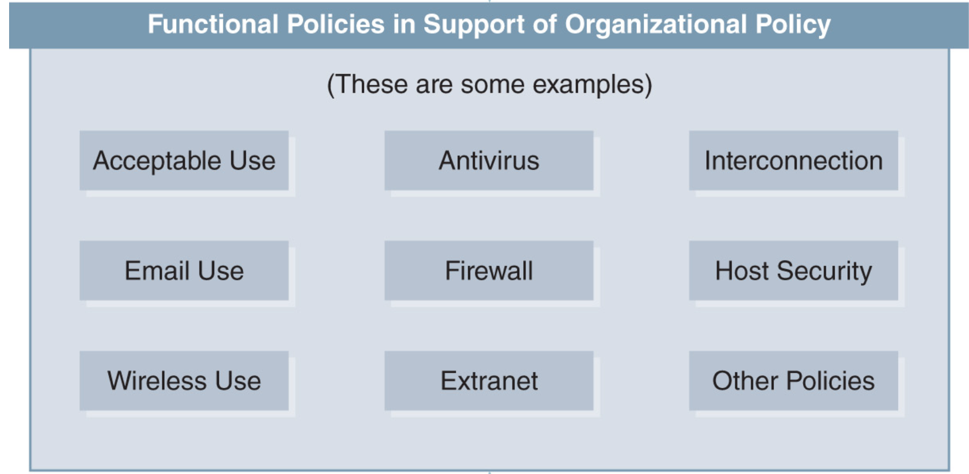
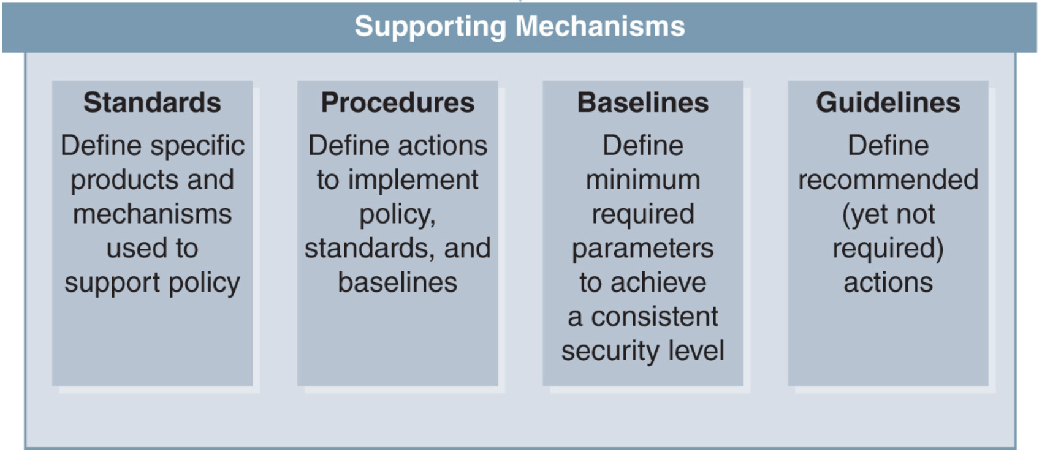
Organizational Security Policy
The University Of Bamenda

Slide 14
Data Classification
Value
Value to the organization;
Value to competitors;
Cost of replacement or loss;
Value to the organization’s reputation.
Sensitivity
Liability or fines, reputation, credibility, or loss of market share.
Criticality
Importance of the information to the mission of the organization
The University Of Bamenda

Slide 15
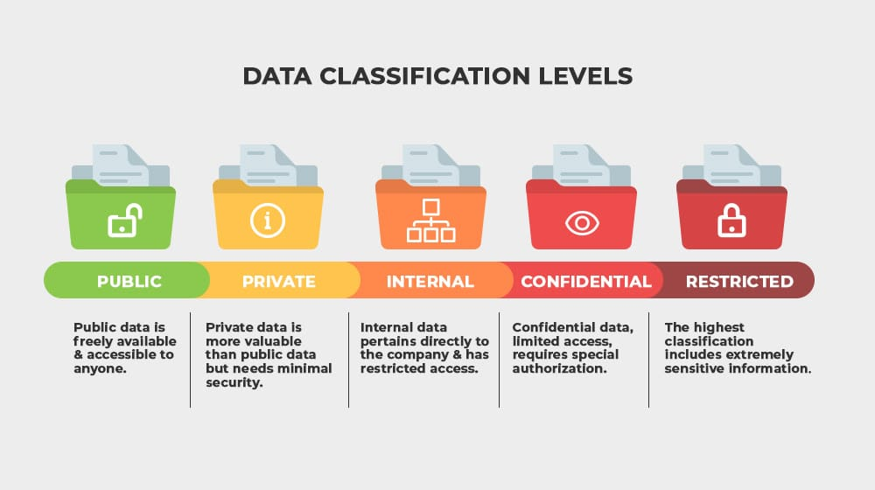
Data Classification Levels
The University Of Bamenda

Slide 16
Configuration Management
Implement a standard naming convention consists of well-defined labels that indicate a component’s function and perhaps even location
Maintain an up-to-date layout of the configuration of all hardware components
Keep copies of all software configurations so that you can examine changes and planned updates
The University Of Bamenda

Slide 17
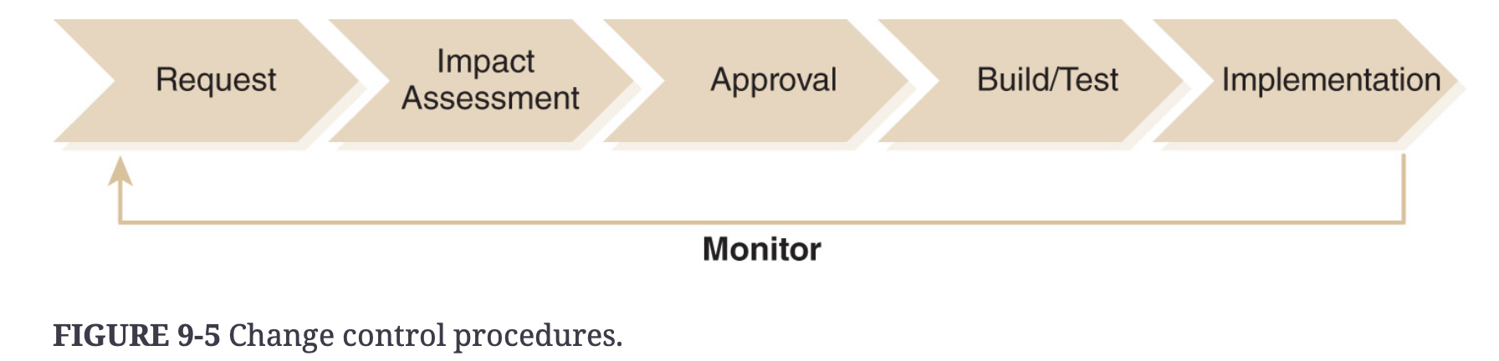
The Change Management Process
The University Of Bamenda

Slide 18
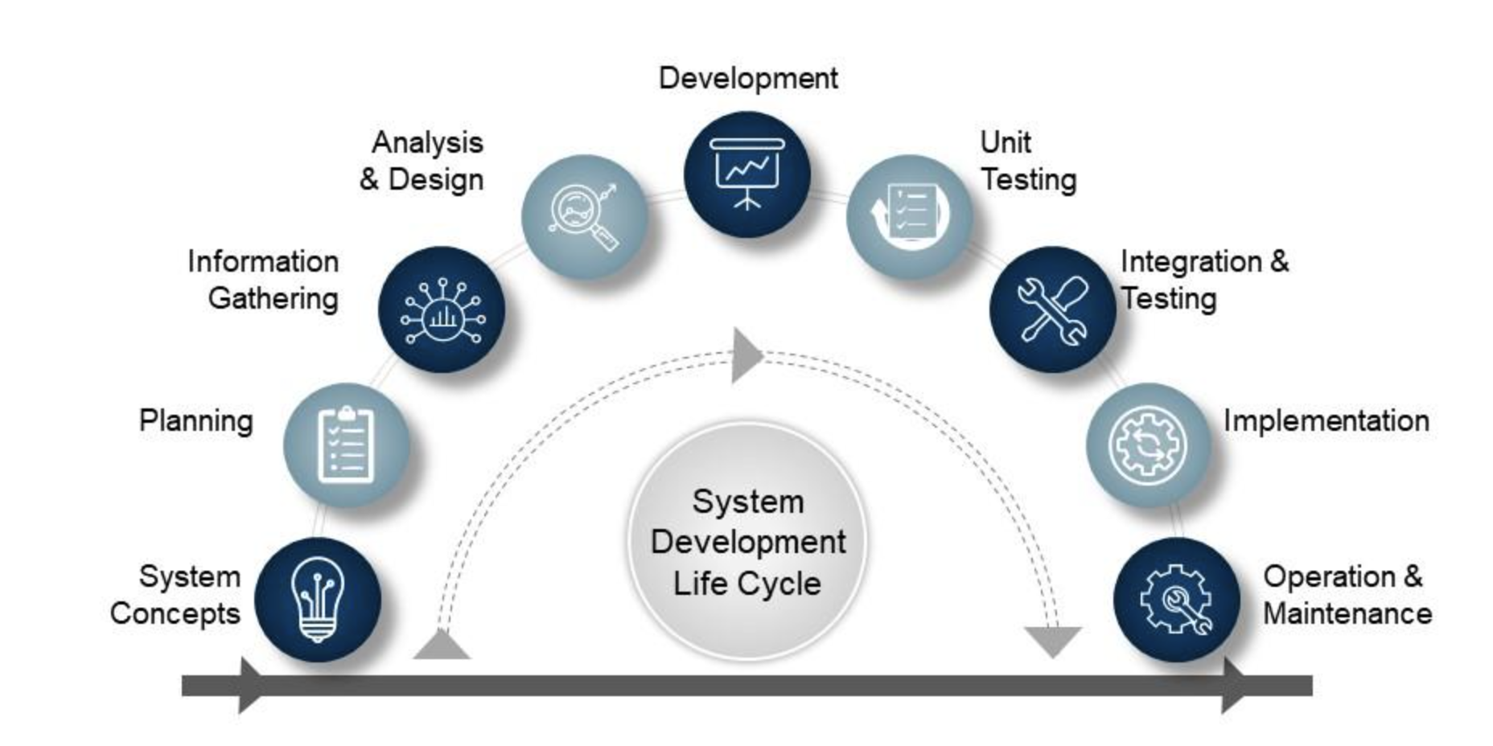
Application Software Security
The University Of Bamenda

Slide 19
Assignment
List and describe 5 defense mechanisms against malware.
Complete and submit assessment.
The University Of Bamenda

Slide 20
Thank You
The University Of Bamenda

